Slide 1

Generative Adversarial Networks (GANs) Clarence Lam

Slide 2
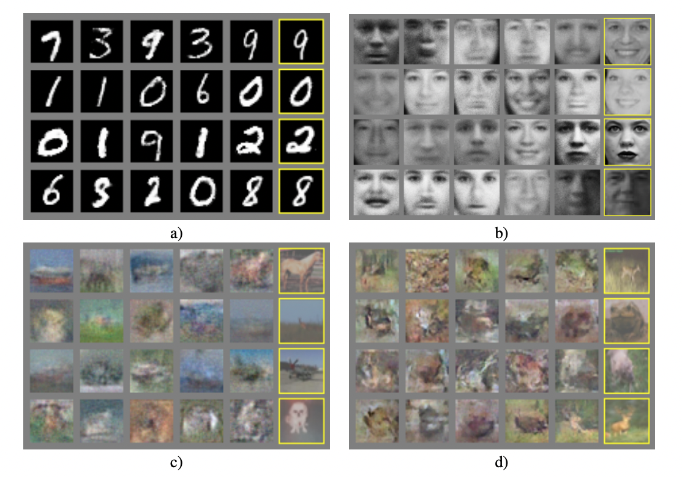
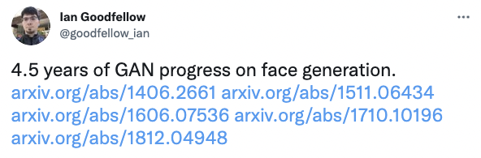
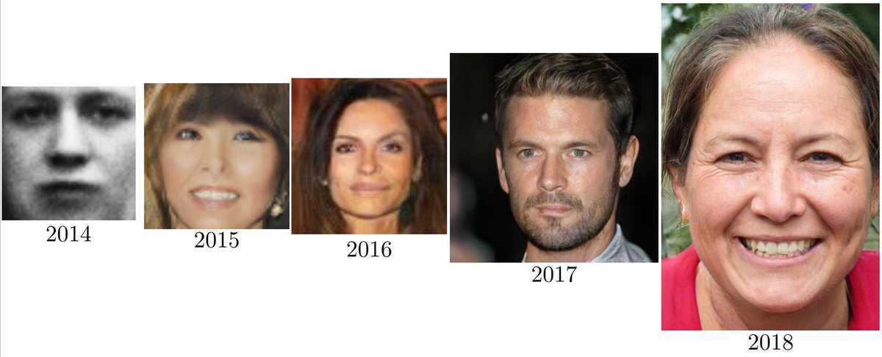
The first GAN (2014)
Goodfellow, I., Pouget-Abadie, J., Mirza, M., Xu, B., Warde-Farley, D., Ozair, S., Courville, A. and Bengio, Y. “Generative Adversarial Networks” Communications of the ACM, 63(11), pp. 139-144 (2014)

Slide 3
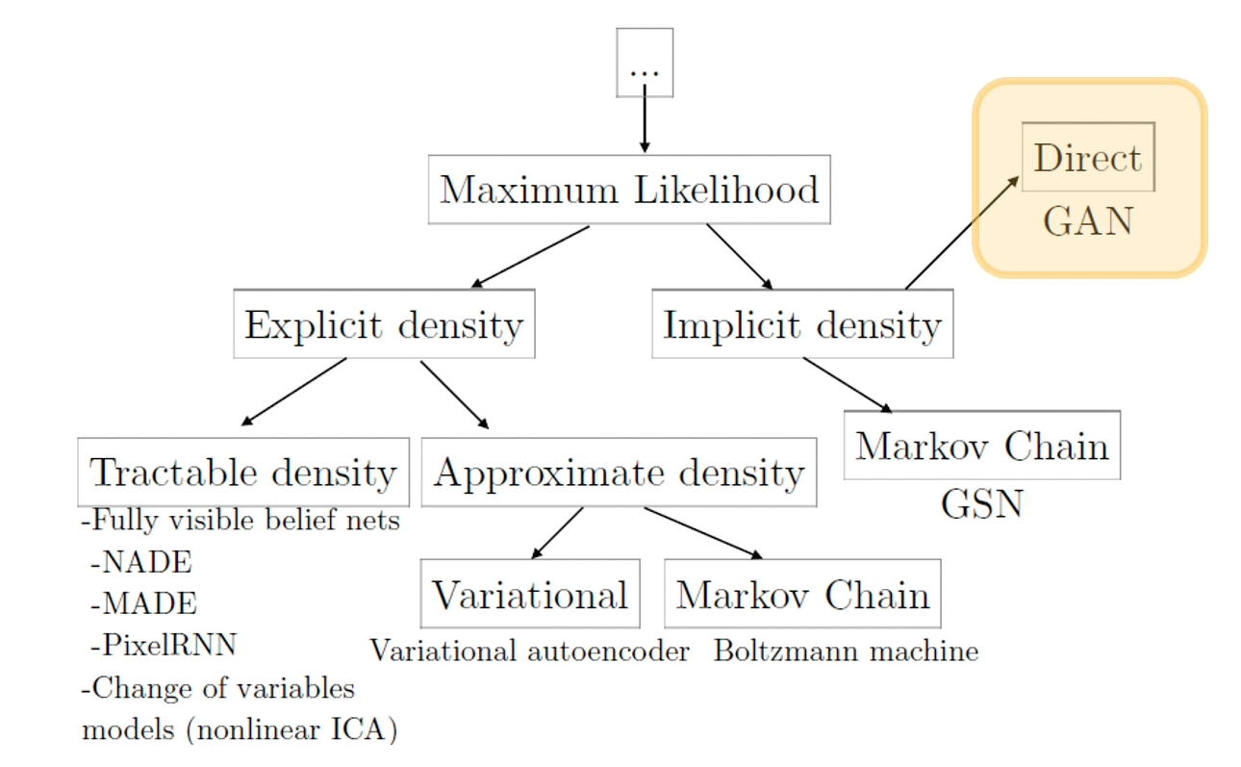
Introduction
A class of generative model that uses of 2 neural networks
Rather than learn from a parameterised density function, it learns a generation process that can give us samples from a joint distribution
Most often associated with generating photorealistic images as a use case
Goodfellow, I. “NeurIPS 2016 Tutorial: Generative Adversarial Networks”
Notes:
GANs do not learn an explicit density function p(x)
Rather, they fit the implicit density category. What that means is that rather than learn a parameterized density function, we will instead learn a parameterized generation process that can give us samples out of a joint distribution.
We won’t have an explicit density to perform things like classification, but we be able to use the unlabeled data to learn how to generate new samples that fits that distribution of that unlabeled data or learn features that might be good for downstream pass.
Implicit generative models do not actually learn an explicit model for p(x)
Instead, we learn to generate or sample from p(x)
It turns out we can learn good feature representations on unlabeled data alone
We can also perform data augmentation and generate new images
We can also learn a simulator

Slide 4
Definition
Generative Adversarial Network
Generative Model
With Competing
Neural Networks
Generator
Discriminator

Slide 5








Generative Models vs Discriminative Models
→
?
feature
class
error
class
features
X → Y
Ɛ , Y → X
Discriminative Models
Generative Models
P( Y | X )
P( X | Y )

Slide 6
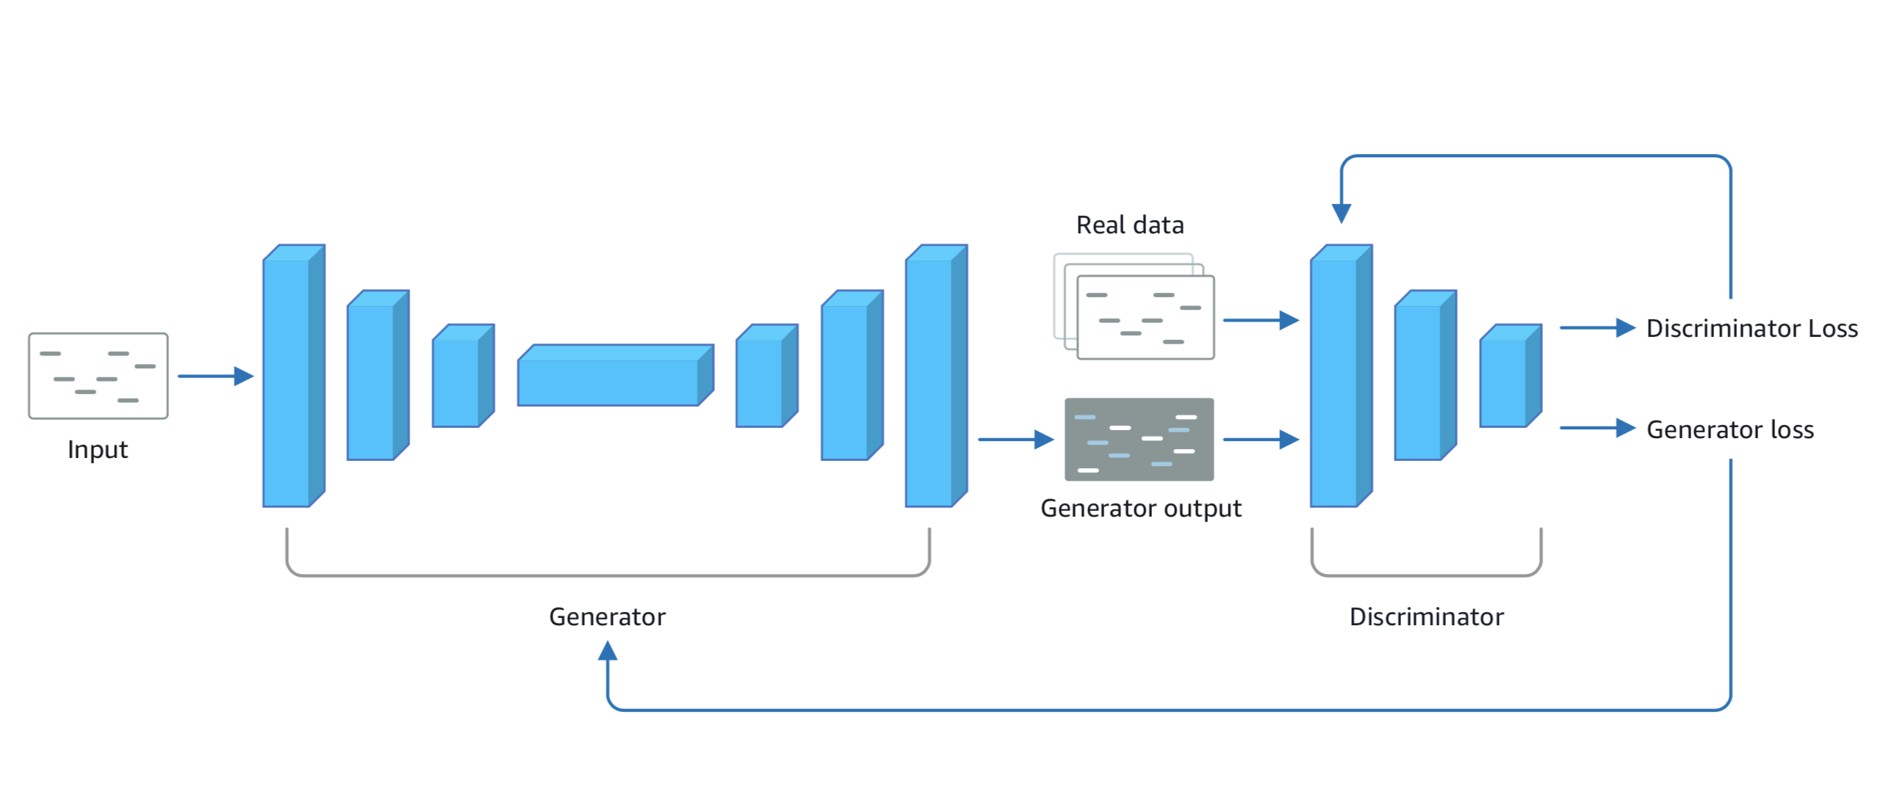
General GAN Architecture

Slide 7
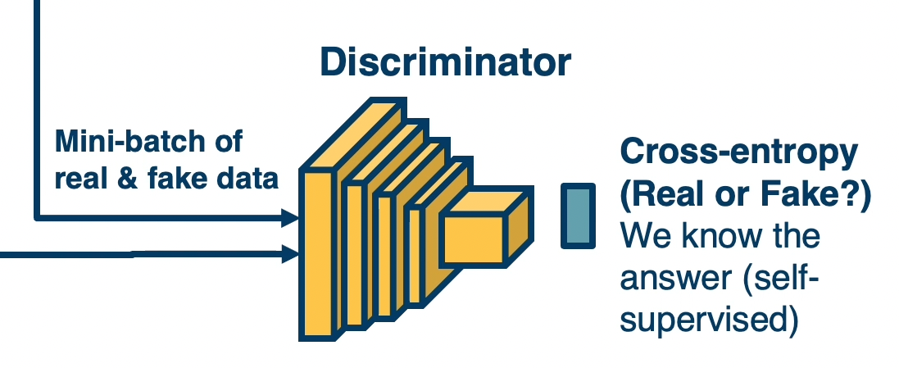
Discriminator
Goal: Update weights to classify real vs generated images
Real Images
Generated
Images
Notes:
In the initial epochs, you will generate random noise. The goal is to generate realistic images.

Slide 8
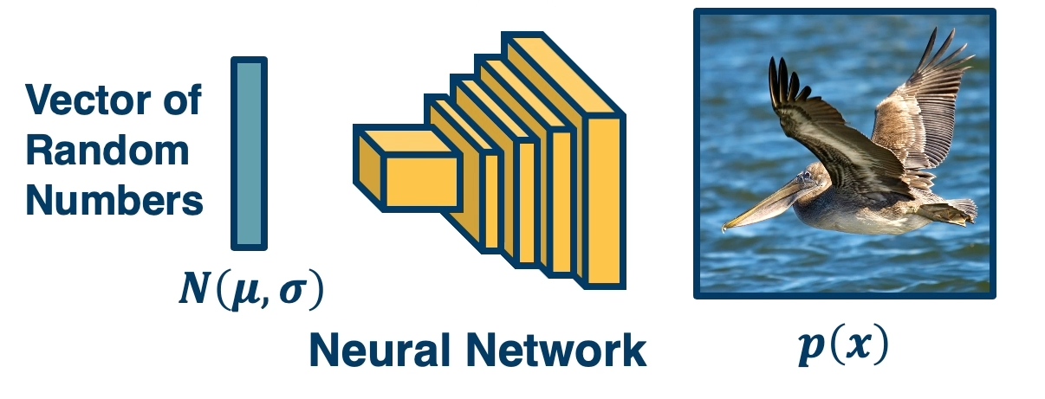
Generator
Goal: Update weights to improve realism of generated images
Notes:
In the initial epochs, you will generate random noise. The goal is to generate realistic images.

Slide 9
Min-max Objective Function
Since we have two networks competing, this is a min-max two player game
Has close ties to game theory
Sampling from fake (0 for fake)
Sampling from real (1 for real)
Where D(x) is the discriminator output probability ([0,1]) of a real image
x is a real image and G(z) is a generated image
High gradient when D(G(z)) is high (discriminator is wrong)
We want to improve when samples are bad (discriminator is right)
Notes:
In the initial epochs, you will generate random noise. The goal is to generate realistic images.

Slide 10
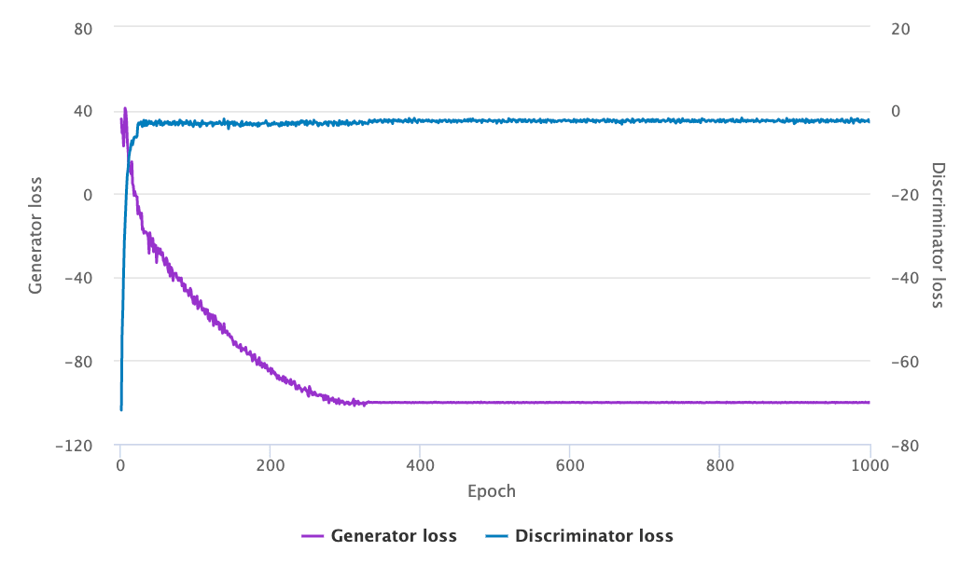
Evaluation
No objective loss function used when training GAN models
Manual inspection of generated outputs is often a good starting point
Frechet Inception Distance (FID) used as a metric currently
There are variants of FID such as Frechet Audio Distance (FAD), Frechet Video Distance (FVD), and Frechet ChemNet Distance (FCD)

Slide 11
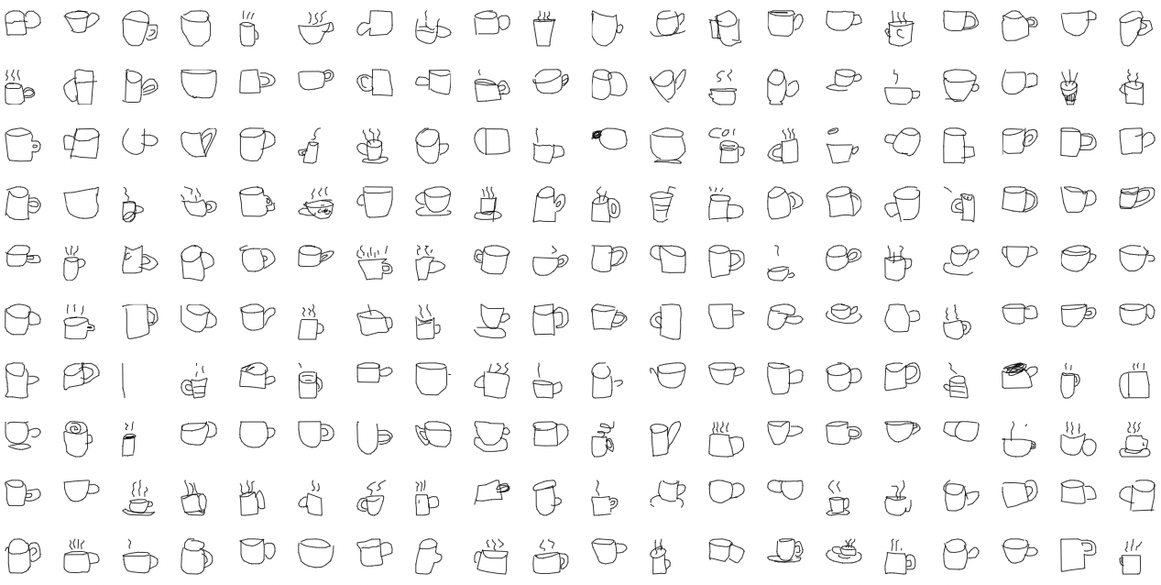
Demo with Sketches

Slide 12
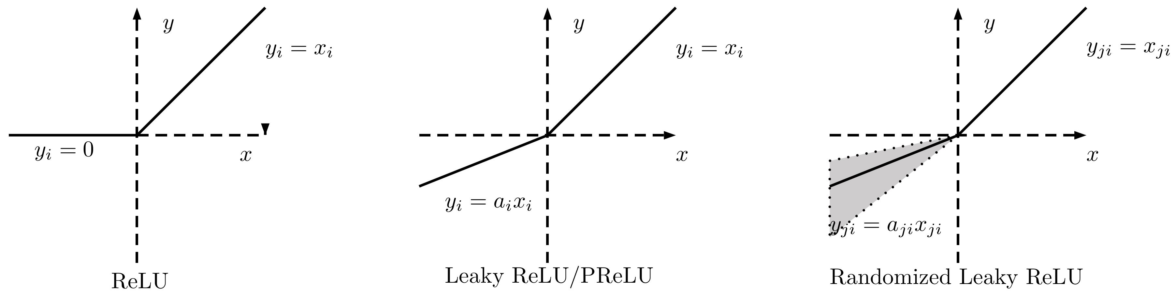
Leaky ReLU Activation

Slide 13
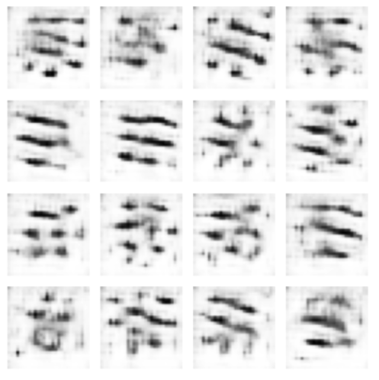
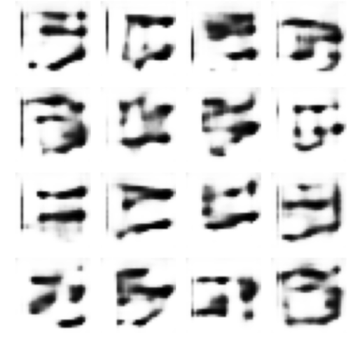
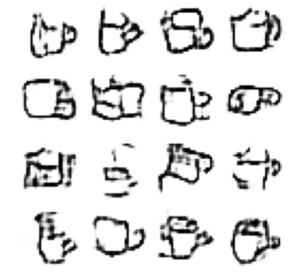
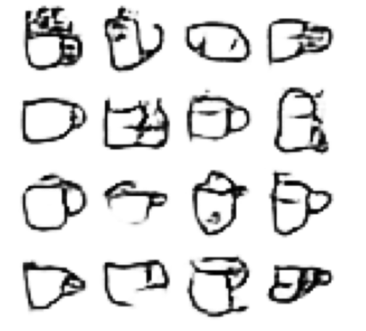
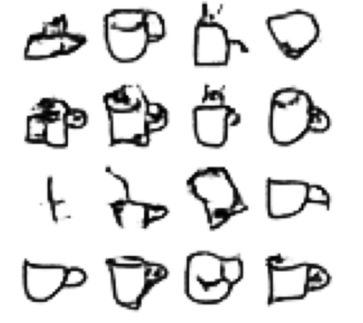
ReLU + DCGAN (Deep Convolutional GAN)
100 epochs
200 epochs
500 epochs
1000 epochs
2000 epochs

Slide 14
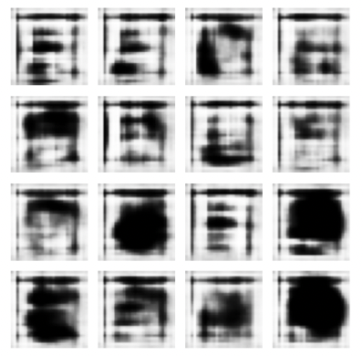
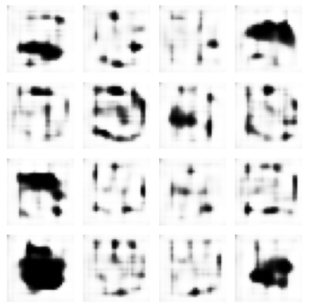
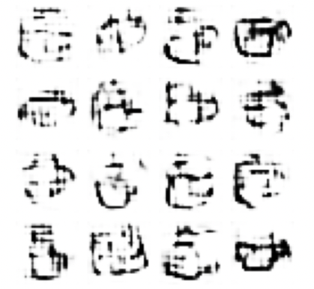
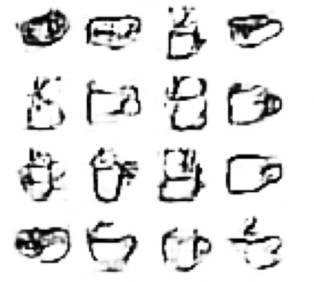
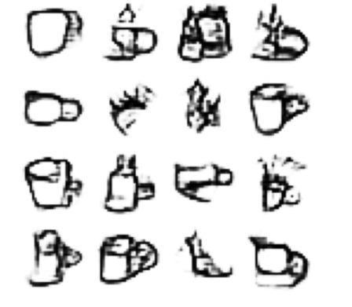
Leaky ReLU (α=0.3) + DCGAN
100 epochs
200 epochs
500 epochs
1000 epochs
2000 epochs

Slide 15
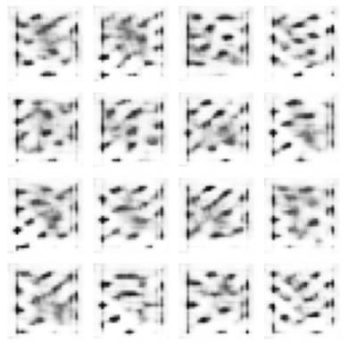
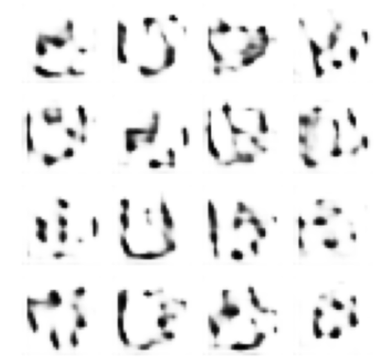
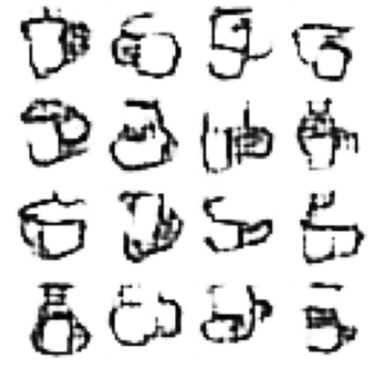
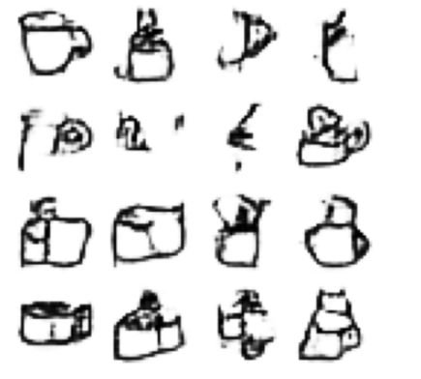
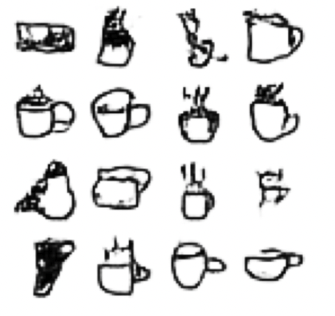
Leaky ReLU (α=0.05) + DCGAN
100 epochs
200 epochs
500 epochs
1000 epochs
2000 epochs

Slide 16
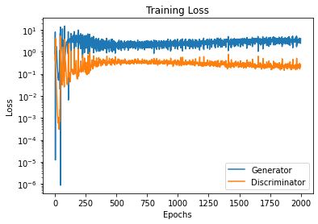
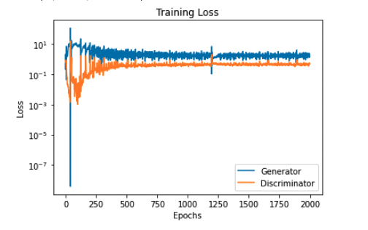
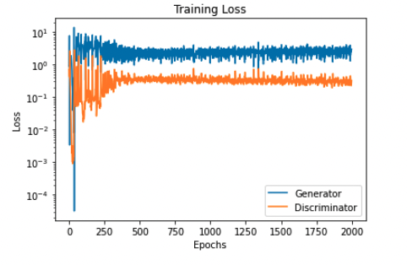
Various Loss on DCGAN
ReLU
Leaky ReLU α=0.3
Leaky ReLU α=0.05

Slide 17
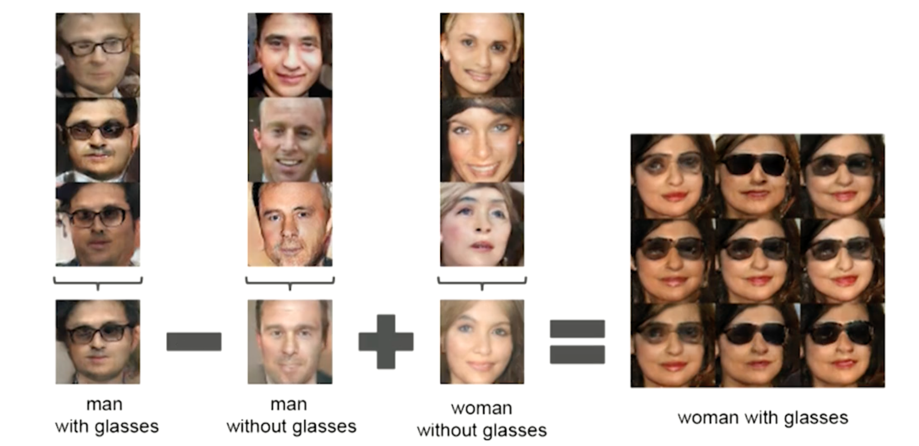
DCGAN (2015-2016)
Using a deep convolutional neural network as a discriminator
The goal is to learn the mapping between an input image and output image
Radford, A., Metz, L. and Chintala, S. “Unsupervised representation learning with deep convolutional generative adversarial networks.” arXiv:1511.06434 (2015)

Slide 18
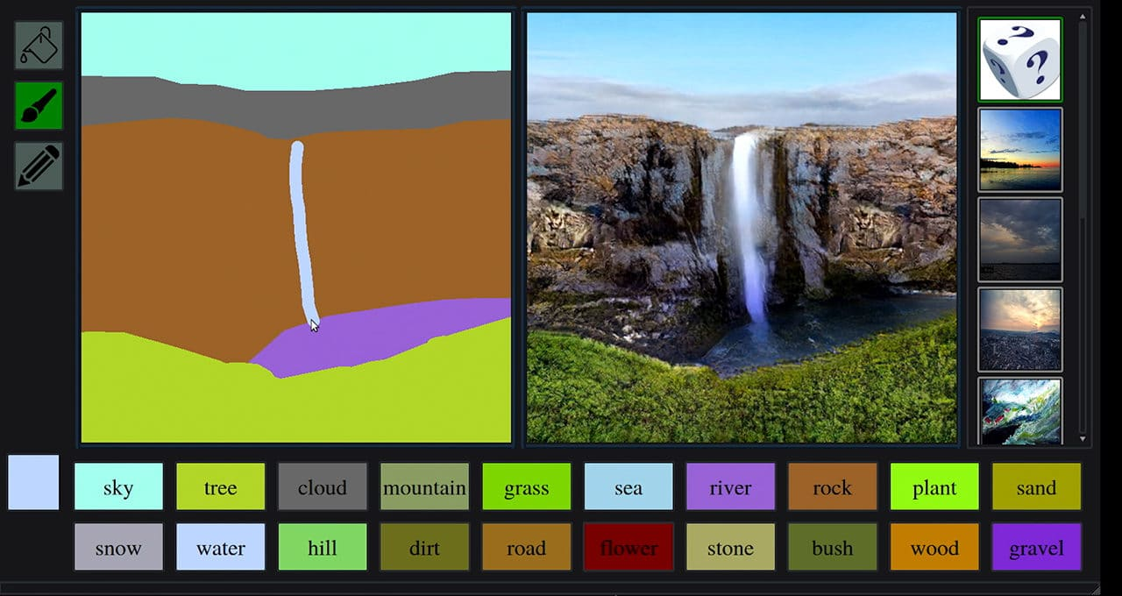
GauGAN (2017)
Image-to-image translation
The goal is to learn the mapping between an input image and output image
Generates photorealistic images based on pre-defined segmentation
Zhu, J., Park, T., Isola, P., Efros, A.A. Unpaired Image-to-Image Translation using Cycle-Consistent Adversarial Networks. Proceedings of the IEEE International Conference on Computer Vision, 2223-2232 (2017).

Slide 19
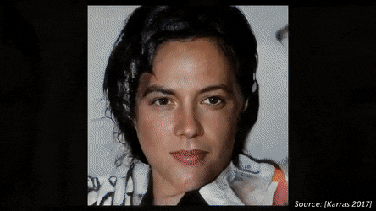
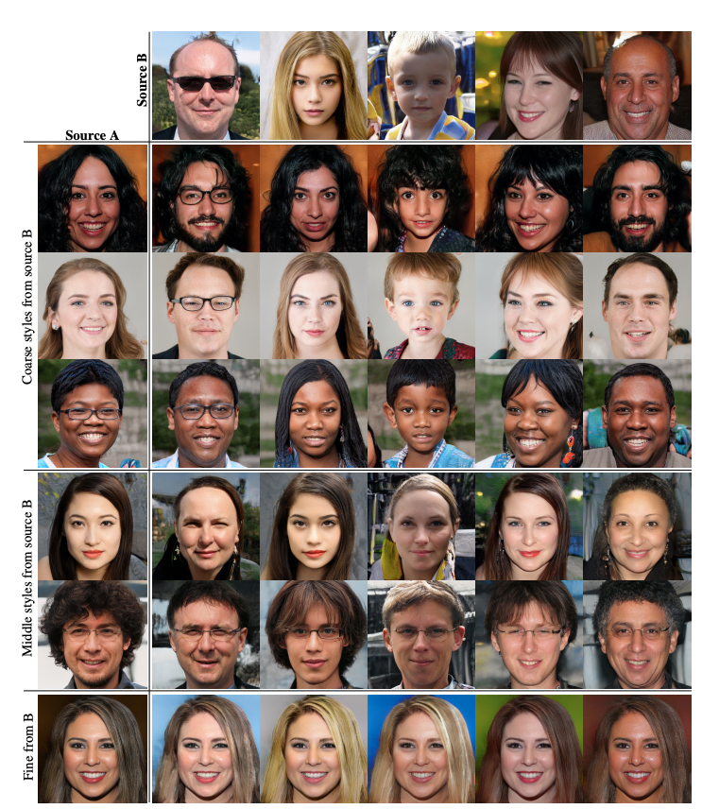
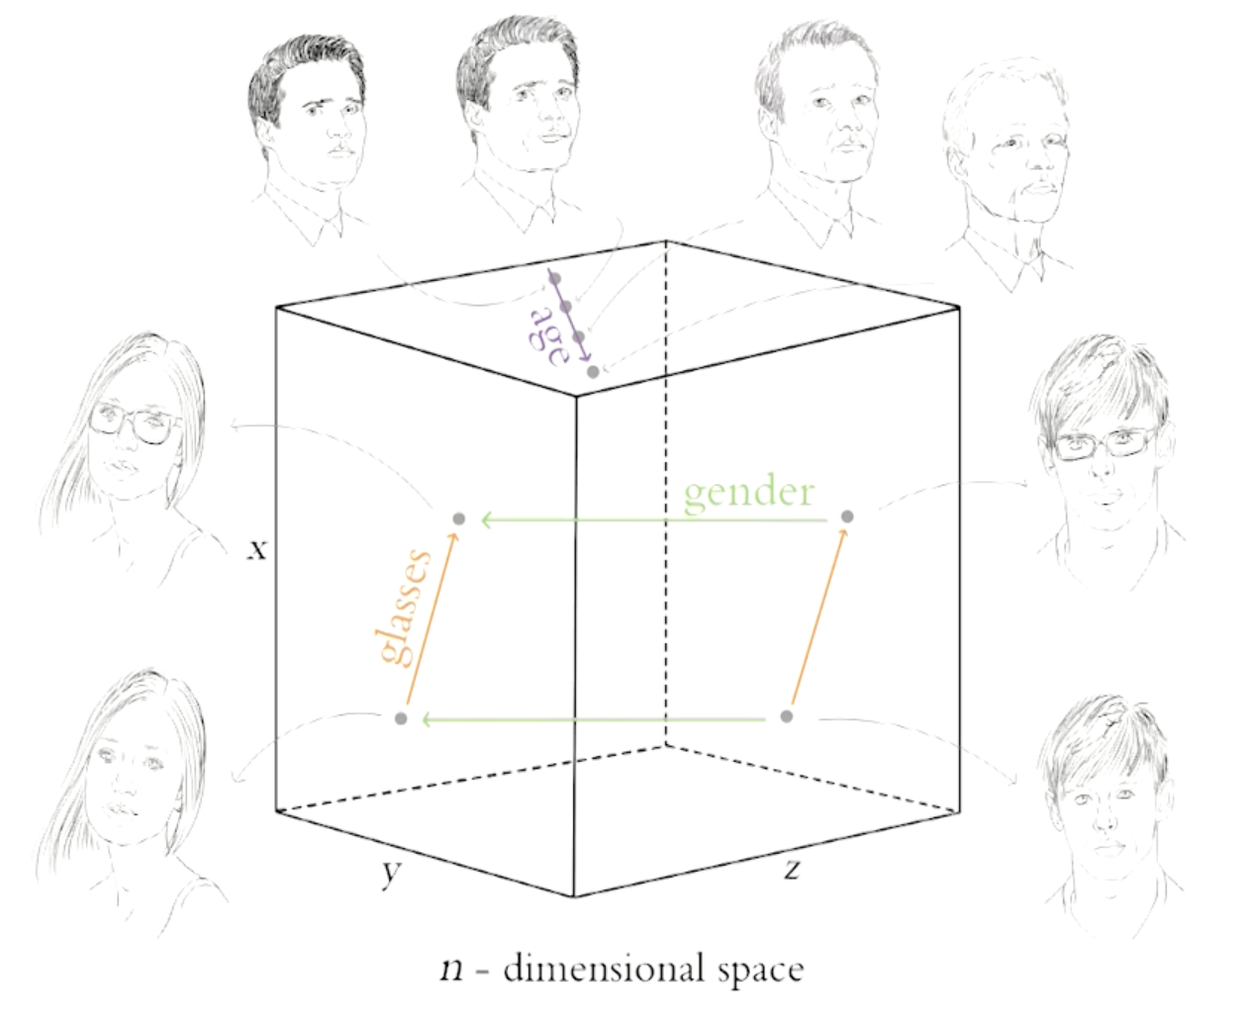
StyleGAN (2018-2019)
GAN architecture focused on improving the generator
Unsupervised separation of high-level attributes (i.e. age, gender) and stochastic variation (freckles, hair)
Karras, T., Laine, S. and Alia, T. “A Style-Based Generator Architecture for Generative Adversarial Networks” Proceedings of the IEEE/CVF Conference on Computer Vision and Pattern Recognition, 4401-4410 (2019)

Slide 20
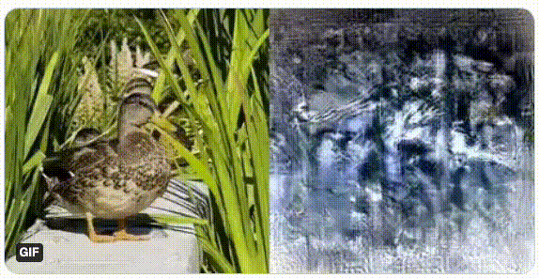
Image Construction from Brain Activity (2019)
Image reconstruction using fMRI scans
Generating visualisations of what a person is thinking / imagining
Shen, G., Horikawa, T., Majima, K., Kamitani, Y. Deep Image Construction from Human Brain Activity. PLoS Computational Biology, 15 (1), doi:10.1371/journal.pcbi.1006633 (2019).
Notes:
Due to a limited dataset in fMRI studies, the DNN does not train directly on the fMRI scans.
Prior to that, the largest fMRI scans that have been used numbered around 6,000 training samples.
-

Slide 21
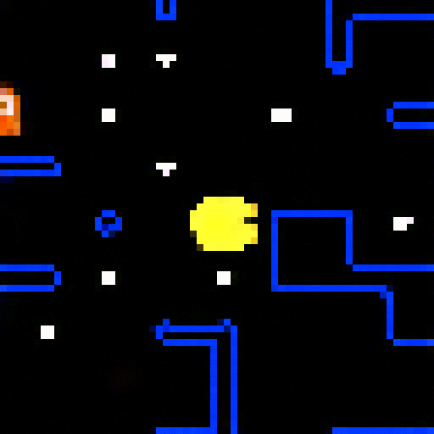
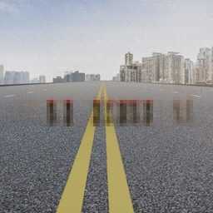
GameGAN (2020)
Generated PAC-MAN game after training on 50,000 episodes of the game
Learns static and dynamic elements of the environment
Learns both simple and complex rules of the game
Seung, W.K., Zhou, Y., Philion, J., Torralba, A., Fidler, S. “ Learning to Simulate Dynamic Environments with GameGAN” Proceedings of the IEEE/CVF Conference on Computer Vision and Pattern Recognition (2020)

Slide 22
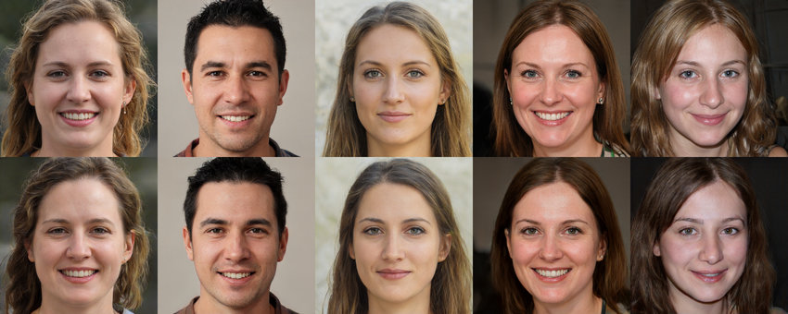
MobileStyleGAN (2021)
StyleGAN2
MobileStyleGAN
Belousov, Sergei. “MobileStyleGAN: A Lightweight Convolutional Neural Network for High-Fidelity Image Synthesis.”
Notes:
StyleGAN2, 28.27M Parameters, 143.15 GMACs, 2.84 FID
MobileStyleGAN: 8.01M Parameters, 15.09 GMACs, 7.75 FID

Slide 23
Summary
Notes:
StyleGAN2, 28.27M Parameters, 143.15 GMACs, 2.84 FID
MobileStyleGAN: 8.01M Parameters, 15.09 GMACs, 7.75 FID

Slide 24
References
Goodfellow, I., Pouget-Abadie, J., Mirza, M., Xu, B., Warde-Farley, D., Ozair, S., Courville, A. and Bengio, Y. “Generative Adversarial Networks” Communications of the ACM, 63(11), pp. 139-144 (2014)
Radford, A., Metz, L. and Chintala, S. “Unsupervised representation learning with deep convolutional generative adversarial networks.” arXiv:1511.06434 (2015)
Karras, T., Laine, S. and Alia, T. “A Style-Based Generator Architecture for Generative Adversarial Networks” Proceedings of the IEEE/CVF Conference on Computer Vision and Pattern Recognition, 4401-4410 (2019)
Karras, Tero. “Analyzing and Improving the Image Quality of StyleGAN” Proceedings of the IEEE/CVF Conference on Computer Vision and Pattern Recognition, (2020)
Belousov, Sergei. “MobileStyleGAN: A Lightweight Convolutional Neural Network for High-Fidelity Image Synthesis.”
Seung, W.K., Zhou, Y., Philion, J., Torralba, A., Fidler, S. “Learning to Simulate Dynamic Environments with GameGAN” Proceedings of the IEEE/CVF Conference on Computer Vision and Pattern Recognition pp. 1231-1240 (2020)
Shen, G., Horikawa, T., Majima, K., Kamitani, Y. “Deep Image Construction from Human Brain Activity.” PLoS Computational Biology, 15 (1) (2019).
Zhu, J., Park, T., Isola, P., Efros, A.A. “Unpaired Image-to-Image Translation using Cycle-Consistent Adversarial Networks.” Proceedings of the IEEE International Conference on Computer Vision, pp. 2223-2232 (2017).

Slide 25
Q&A

